Slide 1


CraftyTech
Developed By:
ADITYA KHARE ( b258 )
SAGAR PATIL ( H229 )
MANISH CHOUDHARY ( H234 )
Submitted to :
Prof. Suraj patil
(course instructor)
CE Department, MPSTME, Shirpur
Notes:
Slide 01:
Good afternoon sir
Today our group is going to present our project work which goes by the title CraftyTech
It consists of various pages
The main technologies that we have used to create are
HTML
CSS
JavaScript
Bootstrap
Ajax
PHP and
Mysql

Slide 2

CraftyTech
This is the project work that our group have developed during the academic course of advanced web programming under the guidance of our course instructor.
Basically, CraftyTech is a website that consists of majorly 4 application namely, chat app, online food and groceries order app, quotes app, and games section which includes 2 abstract games and one quiz game.
Link : http://craftytech.epizy.com/AWPProject/Login_v1/login.html

Slide 3

Technologies Used
CraftyTech website is developed using the following technologies:
HTML
CSS
JavaScript
AJAX
PHP
ANGULARJS
MYSQL
BOOTSTRAP

Slide 4

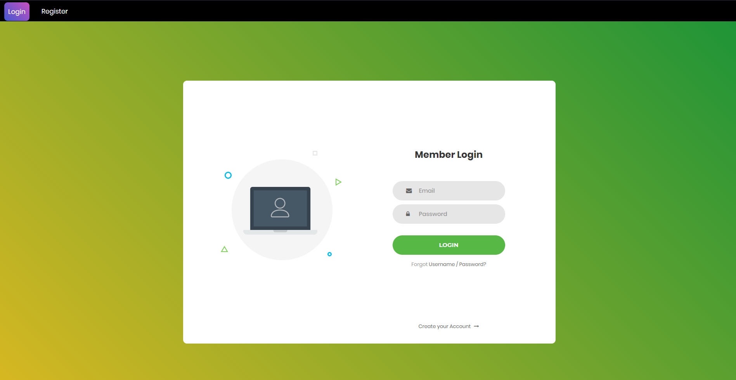


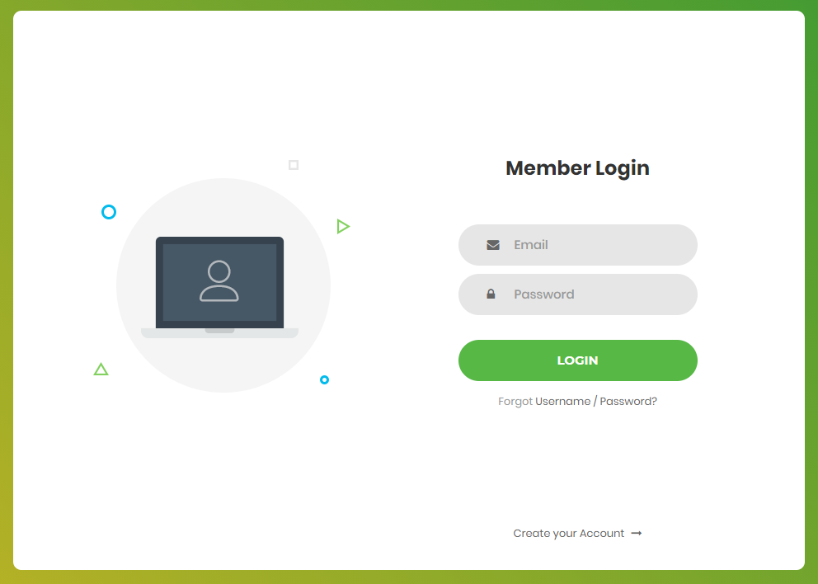

Login Page
Login page is the first page of website, only registered user can login in CraftyTech. For new user there is an option for creating account at the bottom. Once the user has successfully registered, he/she may proceed further and enter his/her login credentials and click submit button if the details entered is registered, he/she will be acknowledged with a welcome message and then redirected to the CraftyTech Home Page.
Notes:
First page of the website is the login page
It includes email and password input fields
If one is not registered as a member then there is a link to for creating an account
There is also a link if one has forgot username or password which will send a mail to the administrator regarding this but due to time constraint, we have not activated this feature.

Slide 5
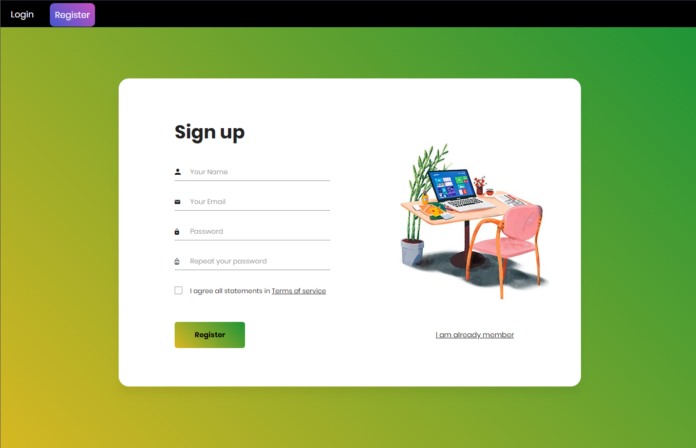
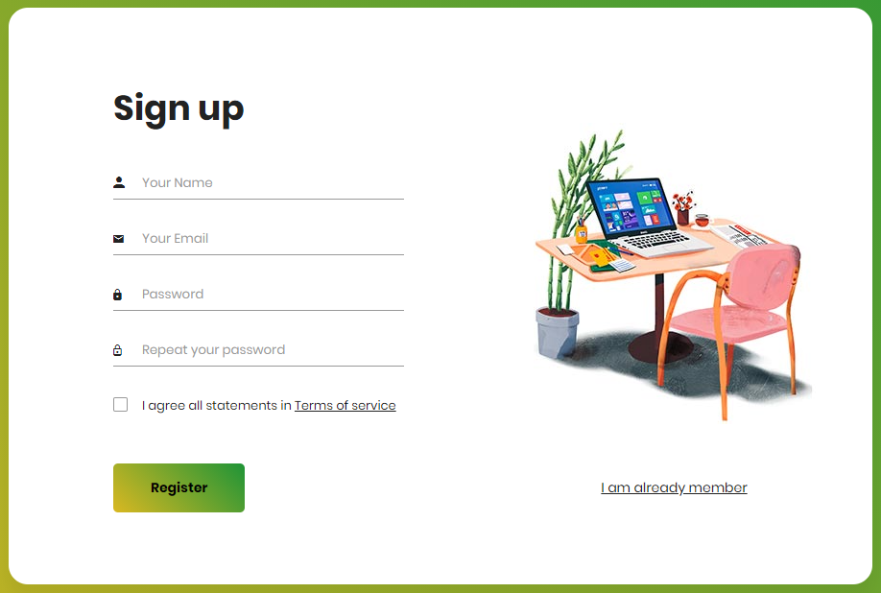
Sign Up Page
When a new user wants to use our website, he/she needs to sign up with CraftyTech for this he/she need to fill the details shown in the picture and agree to terms and conditions and then click Register, once verified The user will get an acknowledgement for successful registration, Then the user may proceed to login into CraftyTech.

Slide 6

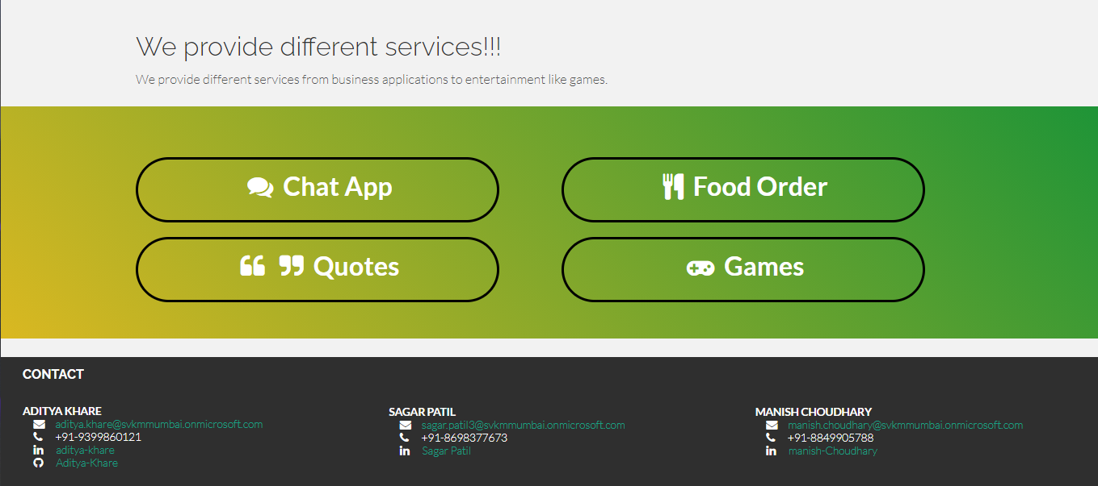
Home Page
The page shown in the picture is the Home page of CraftyTech. The website provides various Features Such as Chat APP , online Food order services , Quotes and Games such as Guess the number , turtle quiz and Pig Game. At the bottom of Home Page, the user can find the contact details for any queries. At the Top right of the home page there is direct link to various features offered by CraftyTech
Notes:
After the successful login in the user will be redirected to the home page of the website.
We have kept 4 major applications in this website i.e.,
Chat application
Food and groceries order application
Motivational quotes suggestion application
And games section
At the end we have included our team’s contact as a footer which includes our mail id’s, LinkedIn account links, GitHub account link and contact no.

Slide 7
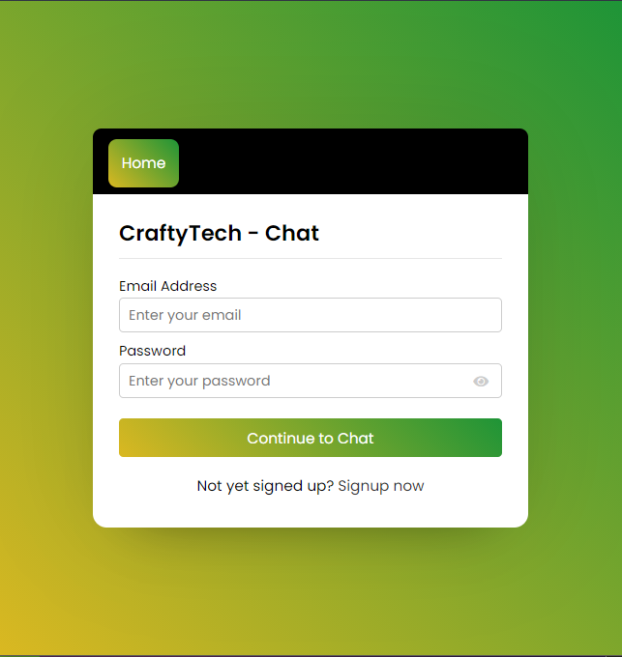
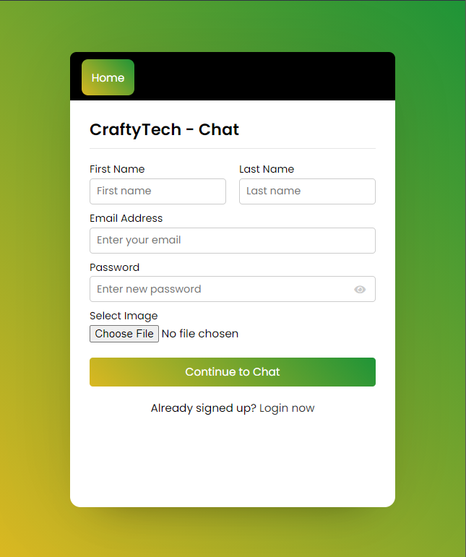
Chat App Page
In this chat app, when you open it first on your browser, there is shown a signup form where you have to signup with your details like name, email, password, and image.
Email and image field is fully validated which means you've to enter a valid email and an image file only.
Once you signed up successfully, you'll be redirected to the user's page where you can see your full name, image, status, and logout button to the top, and users, like you, appear on the bottom if someone has signed up.
On this page, you can see their image, name, status, and the last message if they sent to you. You must click on the user, or you can also search any existing user with their name then you'll be redirected to the chat page and there you can see the image, name, status of that user who is going to chat.
Notes:
Let us see the chat app

Slide 8
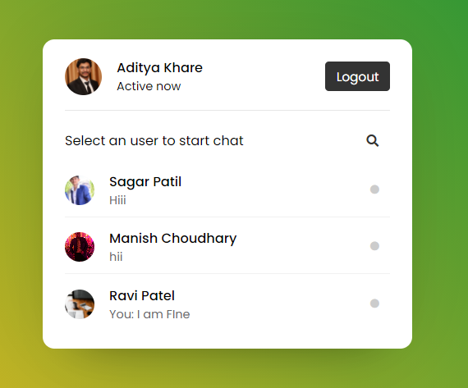
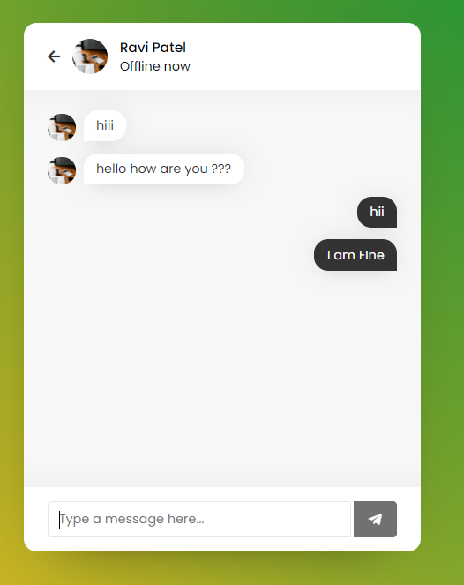
Chat App
Once you logout, you can again login and with your email and password that you used to when signing up for the form.
If you entered the correct credentials, then you'll be redirected to the user's page and all other users will immediately know that you've logged on and now active.

Slide 9
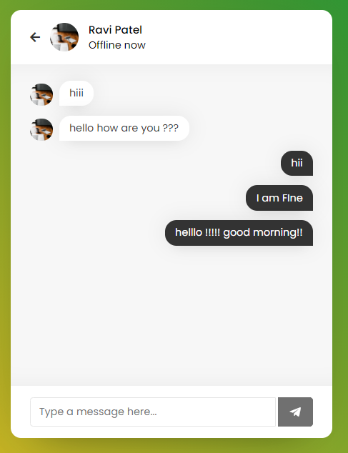
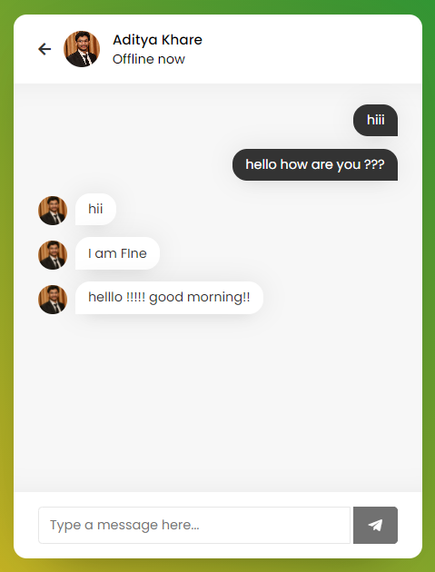
Chat App
Once you send a message to another user then immediately that message appears in your chat box and another user chatbox too which you've sent the message.
On the message receiver chatbox, this user received the message with the sender image. Remember chatbox will be automatically scrolled to the bottom once the chatbox starts scrolling.
You can logout from the chat application at any time and once you logout, immediately all other users will know that you've been log out or offline.

Slide 10
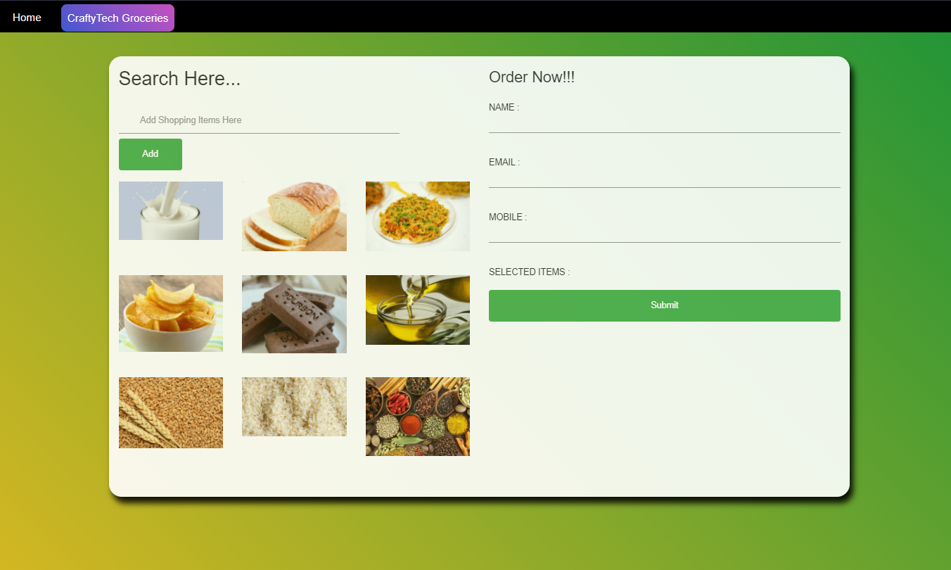
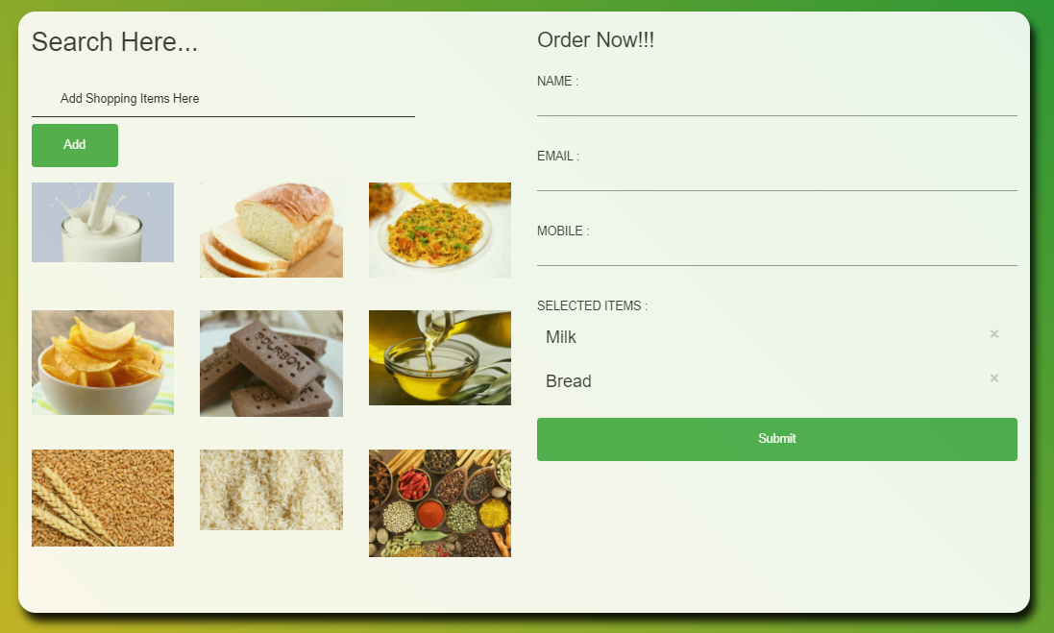
Order Online Page
One More Feature offered by CraftyTech is Food Order. The user can type required item name in the area provided below ‘Search Here’, After writing the item name the user simply must click add button to add the item to order.
To place a successful order user must fill all the required details and click submit button , after click of submit button, an acknowledgement will be given informing about successful Order placement.

Slide 11
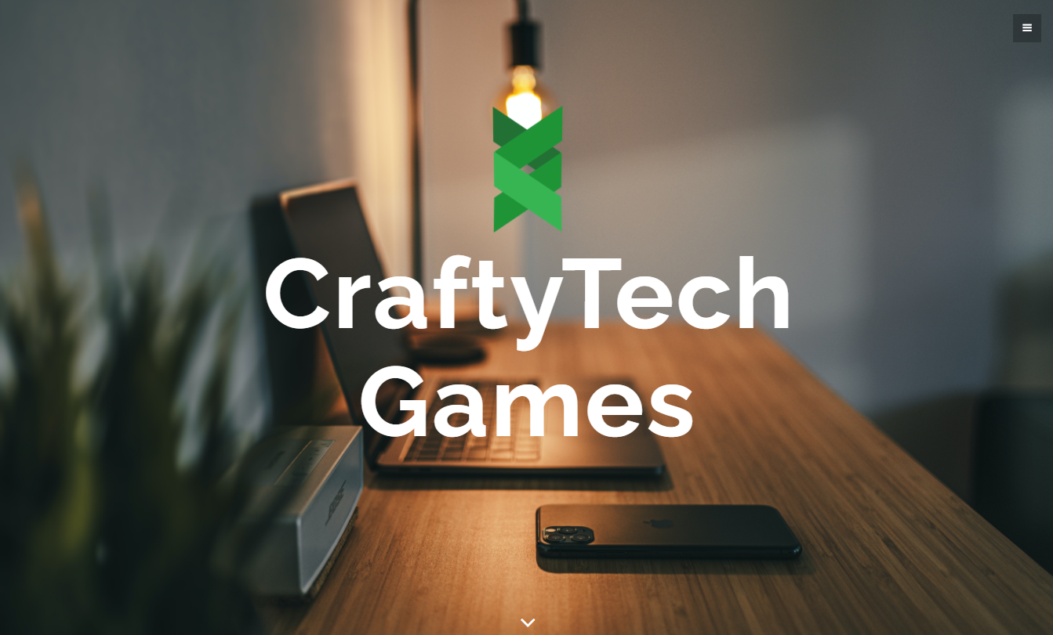
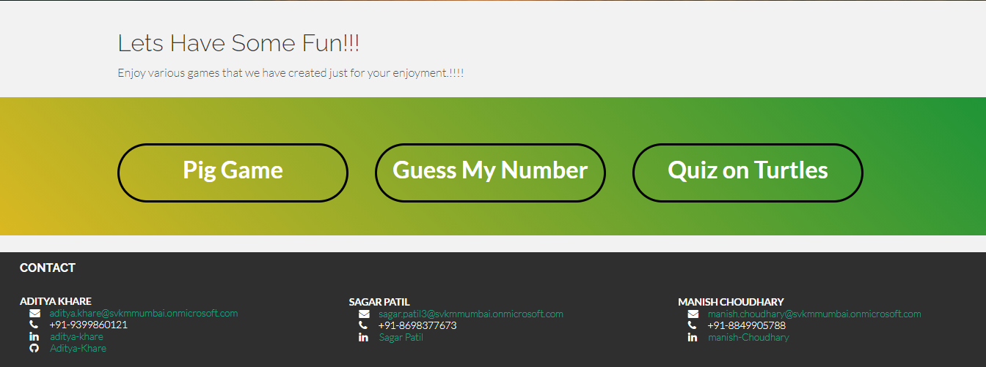
Games Section Page
The page shown in the picture is the Game Section page offered by CraftyTech. To play any game user simply must click on the desired game and hence will be redirected to the game and hence, can enjoy the fun. The various games offered by CraftyTech is Pig Game , Guess My Number and Quiz on Turtles.

Slide 12
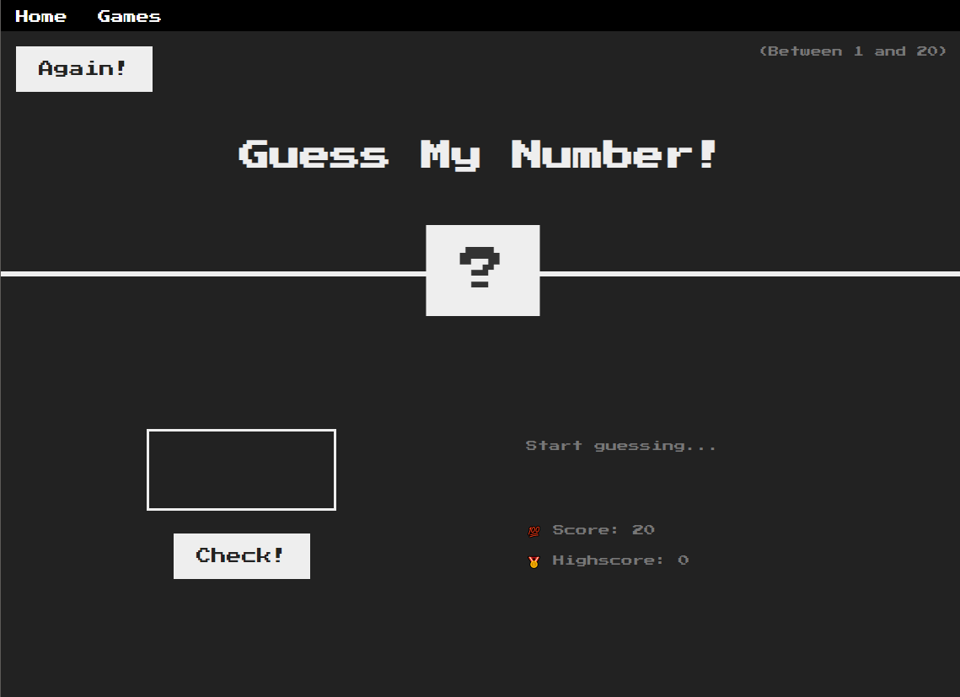
Guess Number Game Page
To play the game user enters a number in the box provided and click on check if the number is below the correct number, then the user gets acknowledgement as too small and too large if the number entered is greater then the correct number. Once the number is guessed, correct number acknowledgement is given, and the Score is displayed.

Slide 13
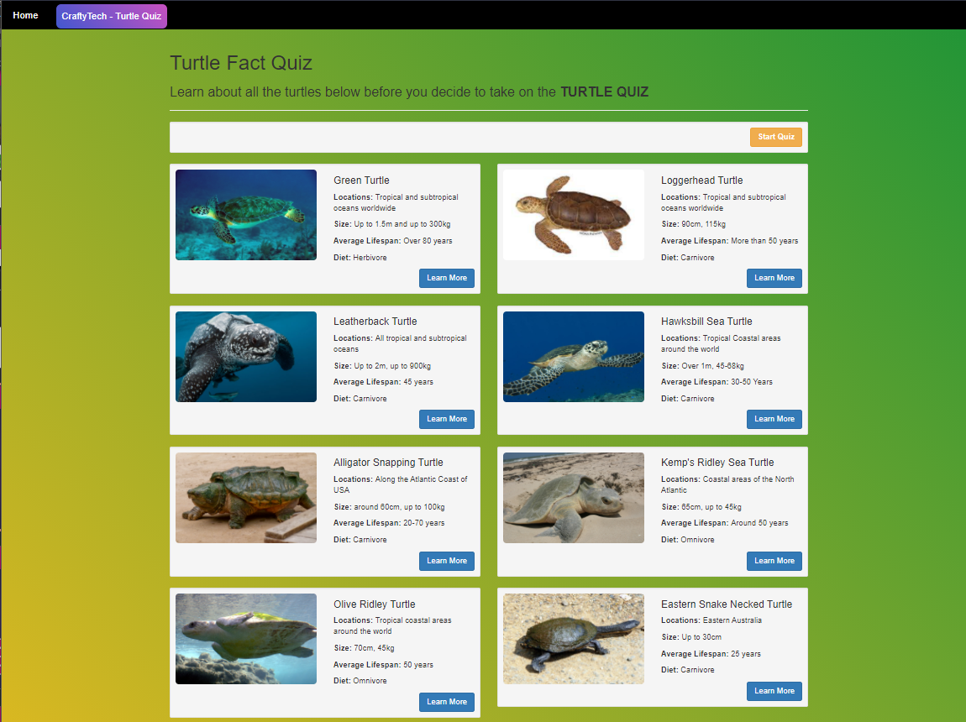
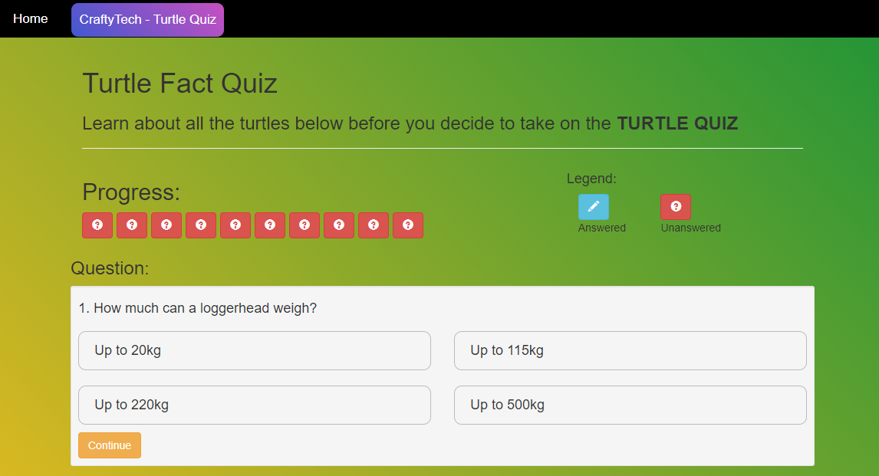
Turtle Fact Quiz Page
In The Turtle Fact Quiz Game, The user can read and learn about various turtles as shown in picture. The user can click learn more to learn more about that turtle after the user feels confident enough that he has learned everything about all the turtles listed he/she may proceed with quiz by clicking start Quiz. The Quiz window is shown in the picture, The progress will represent right symbol once that question is attempted and after submitting the quiz a result will be generated displaying the knowledge of the user of the turtles in the Game.

Slide 14
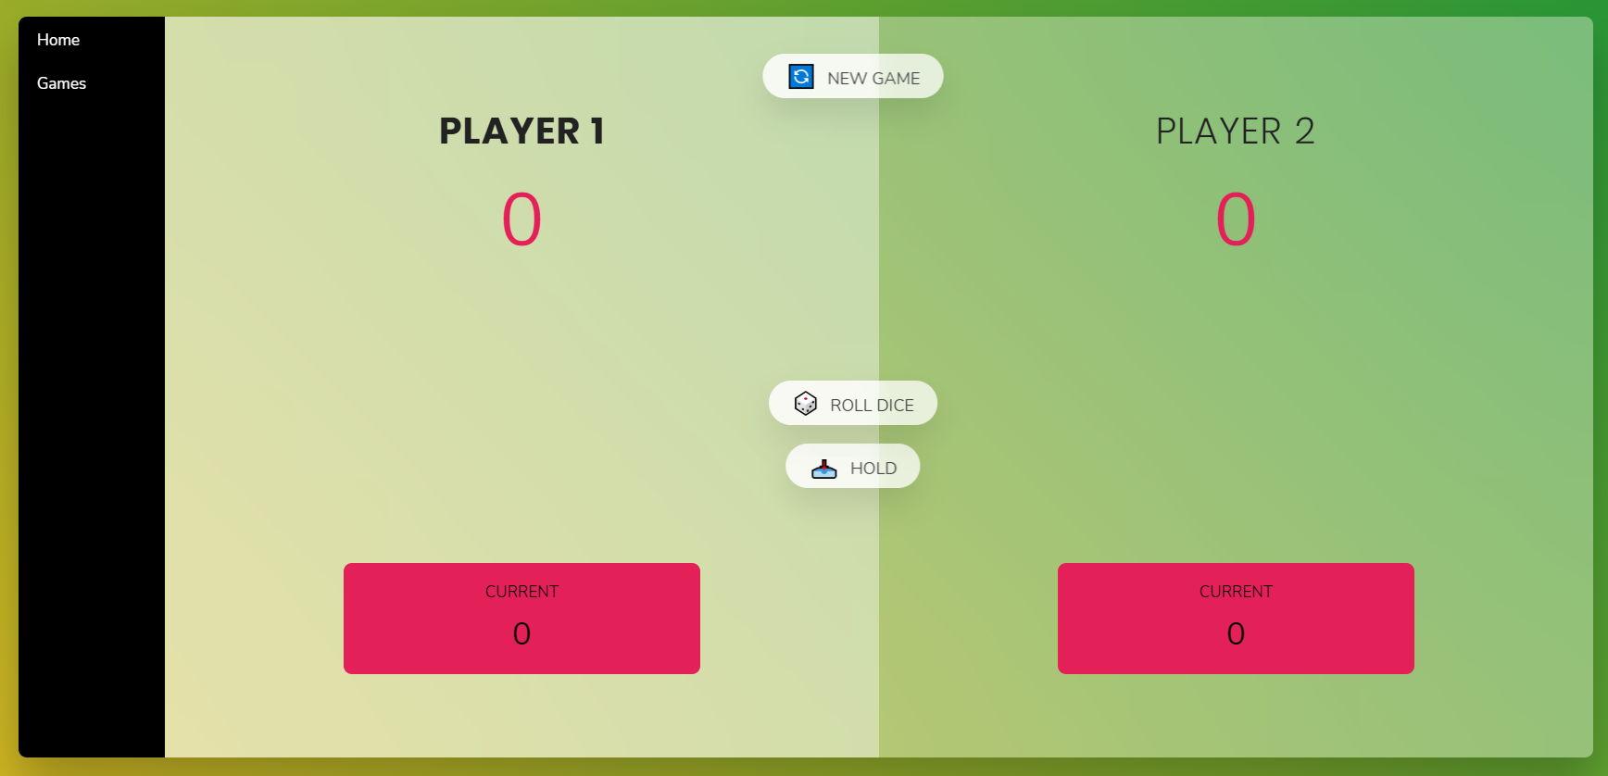
Pig Game Page
Choose a player to go first. That player throws a die and scores as many points as the total shown on the die providing the die doesn’t roll a 1. The player may continue rolling and accumulating points (but risk rolling a 1) or end his turn.
If the player rolls a 1 his turn is over, he loses all points he accumulated that turn, and he passes the die to the next player.
Play passes from player to player until a winner is determined.
The first player to accumulate 100 or more points wins the game.

Slide 15
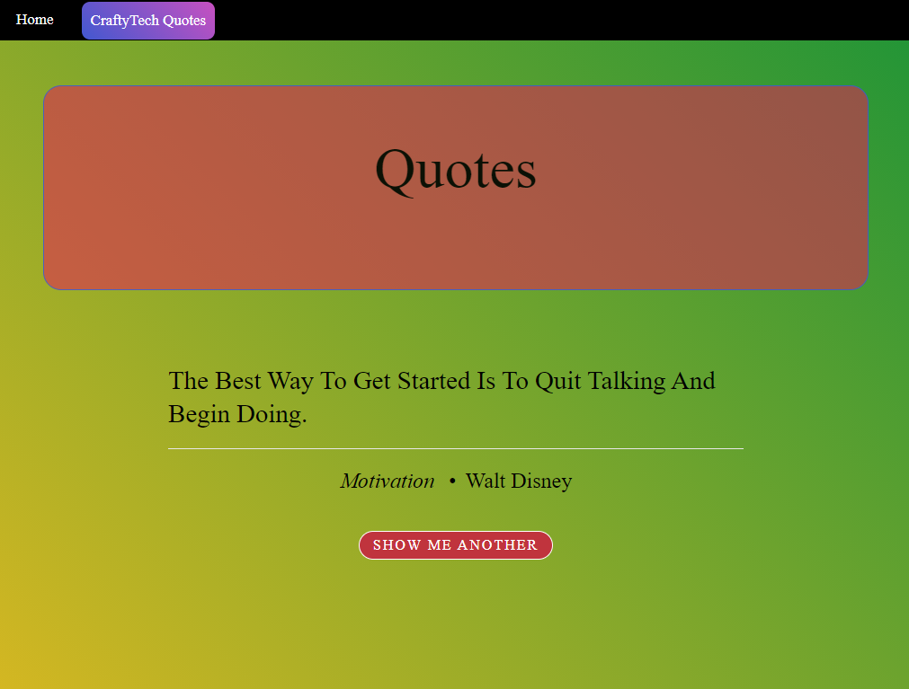
Quotes Page
The Quote Page must be visited by Users to see different Quotes by Various Persons on Various Topics such as Experience, Joy , Friendship, Technology , etc.

Slide 16

Conclusion
CraftyTech is a website that was successfully developed by our team as a project using different technologies, under the guidance of our course instructor, during the academic course of Advanced Web Programming. By developing this project, we got hands on knowledge of the technologies that are we used which will be beneficial for us in the future.

Slide 17
THANK YOU

